Slide 1
Dual Active Bridge

Slide 2
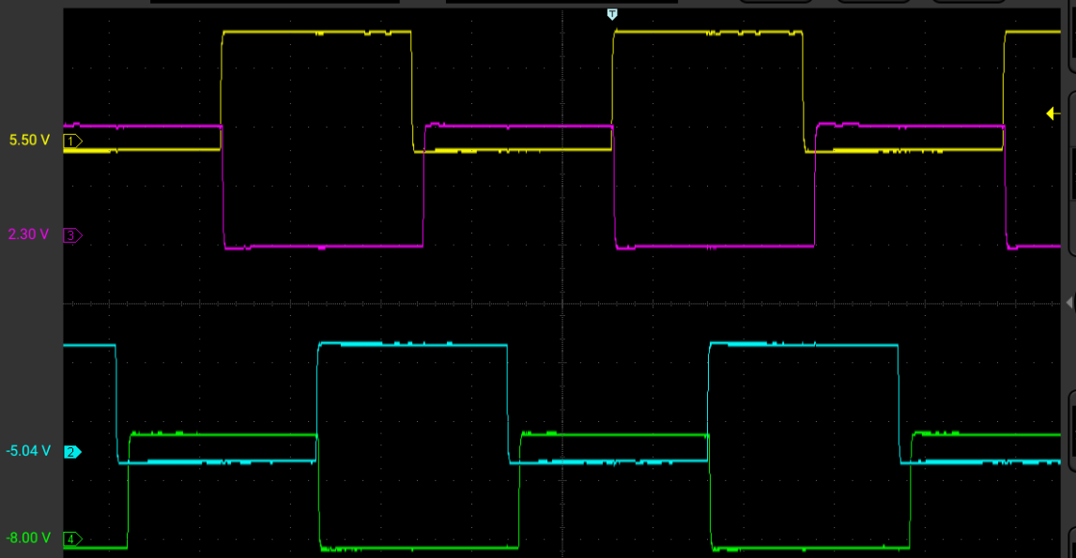
PWM Configuration – Cascaded PWM 1-2-3-4
PRItoSEC Phase 90 – (Bridge Phase / 2)
PWM1
PWM3
Bridge Phase 180 – 360 degrees
PWM2
PWM4

Slide 3
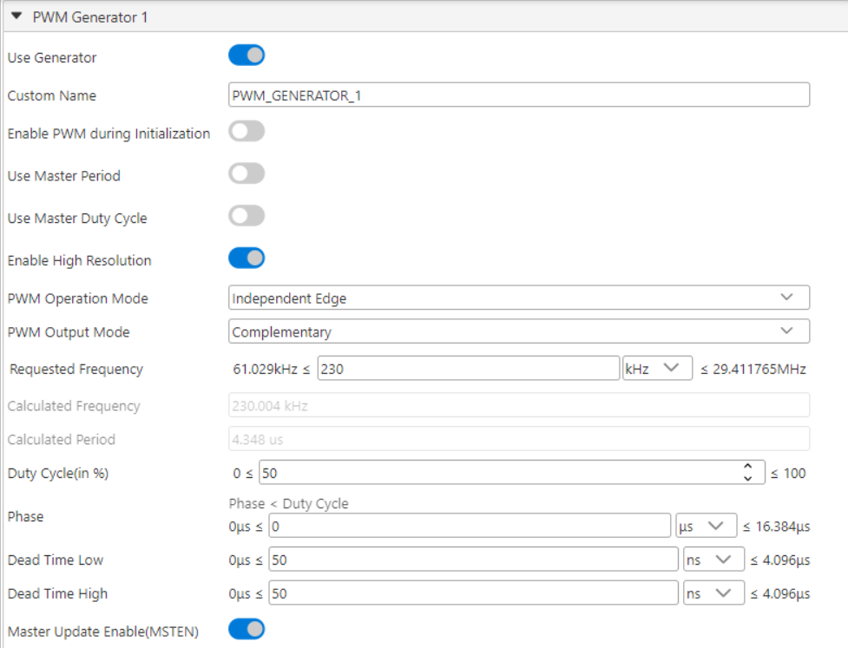
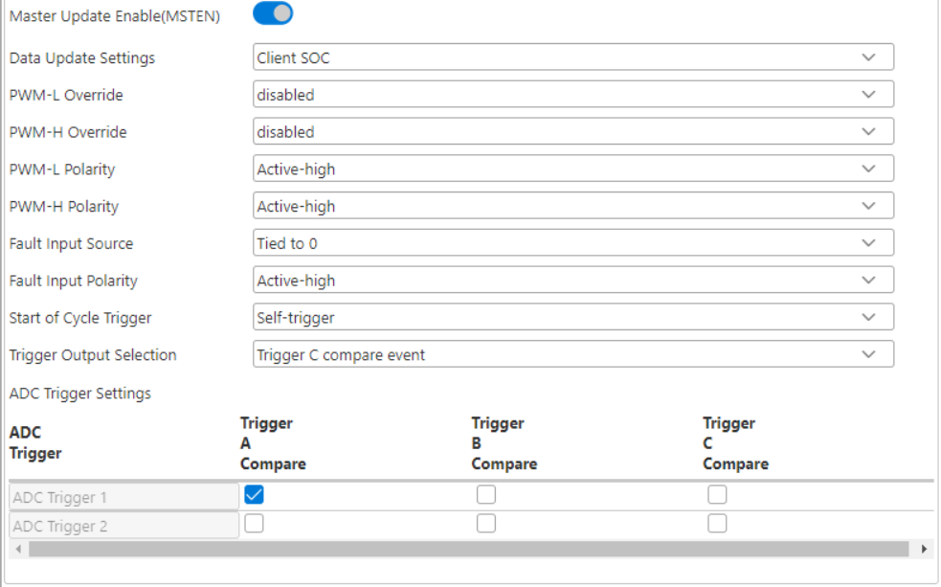
MCC PWM1

Slide 4
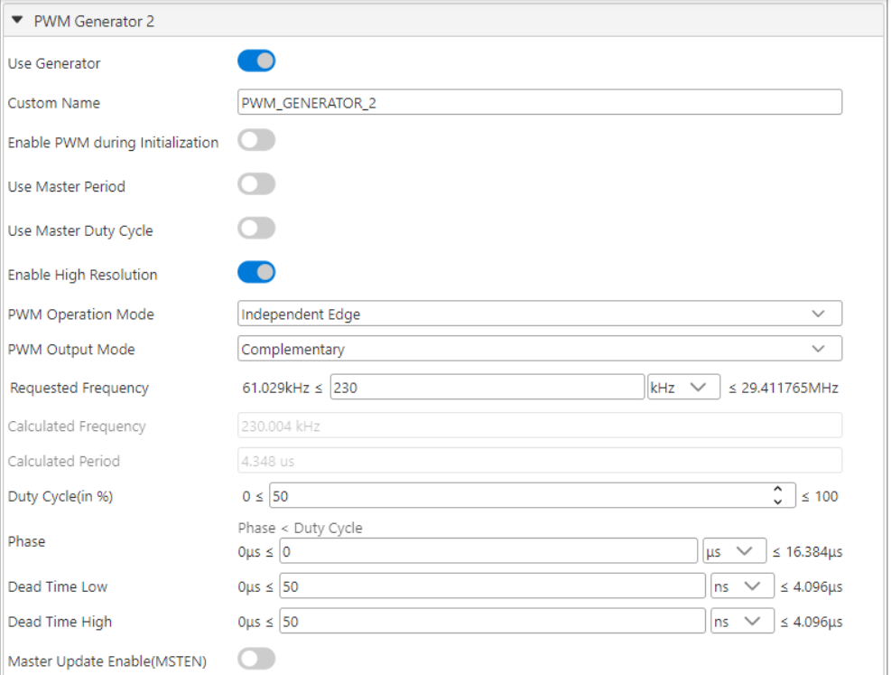
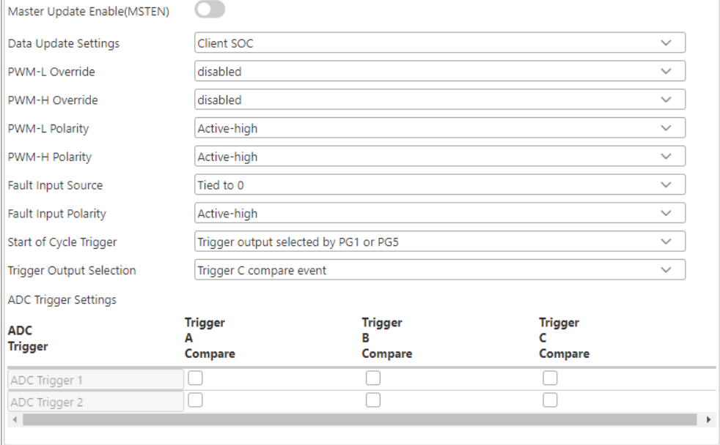
MCC PWM2

Slide 5
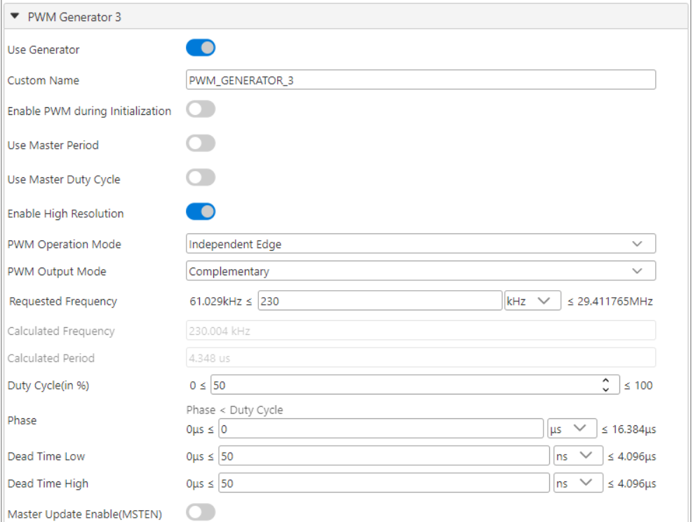

MCC PWM3

Slide 6
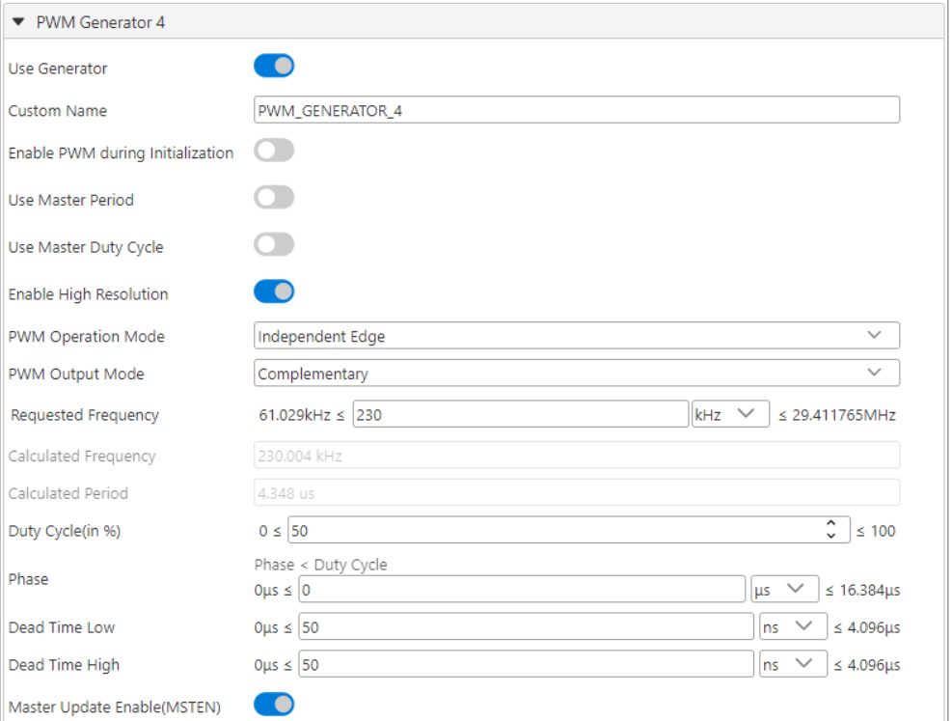
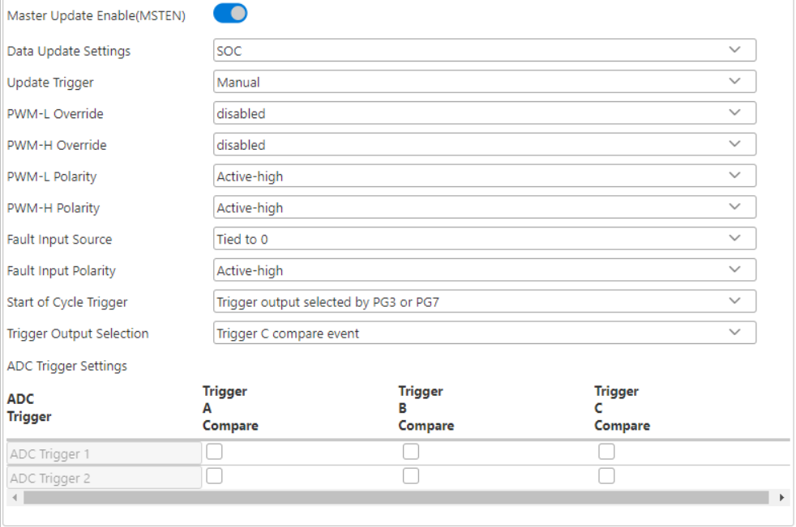
MCC PWM4

Slide 7
FB_Vdd-PWM_P fault implementation
SCCP2 input capture
CLC2
DMA2

Slide 8
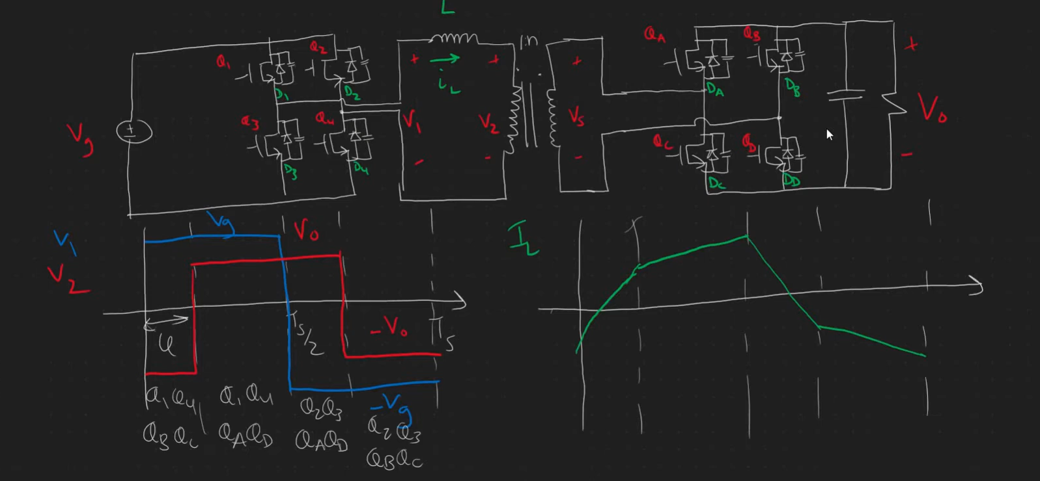
DAB operation

Slide 9
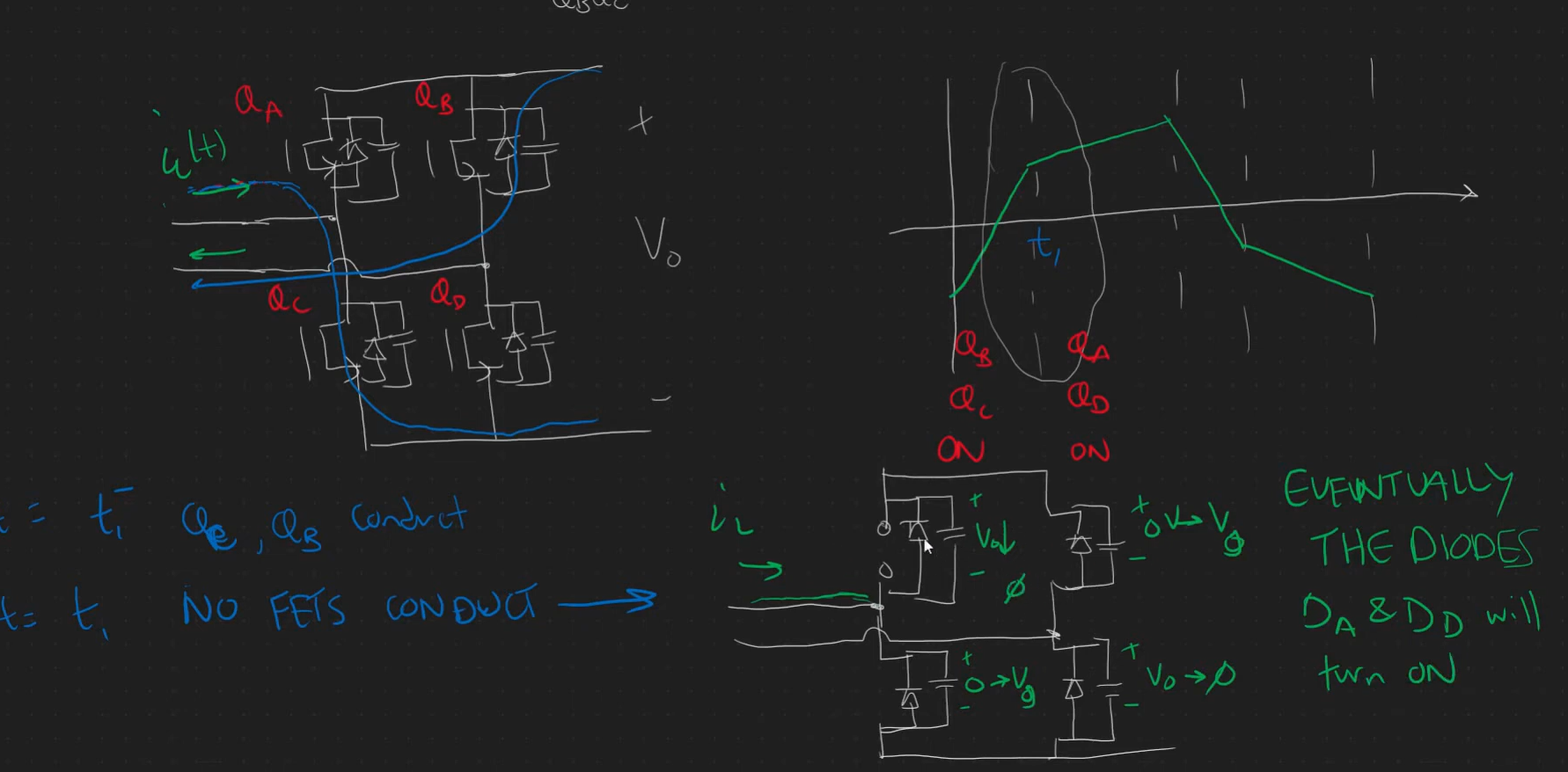
Inductor current naturally forces commutation of Diode

Slide 10
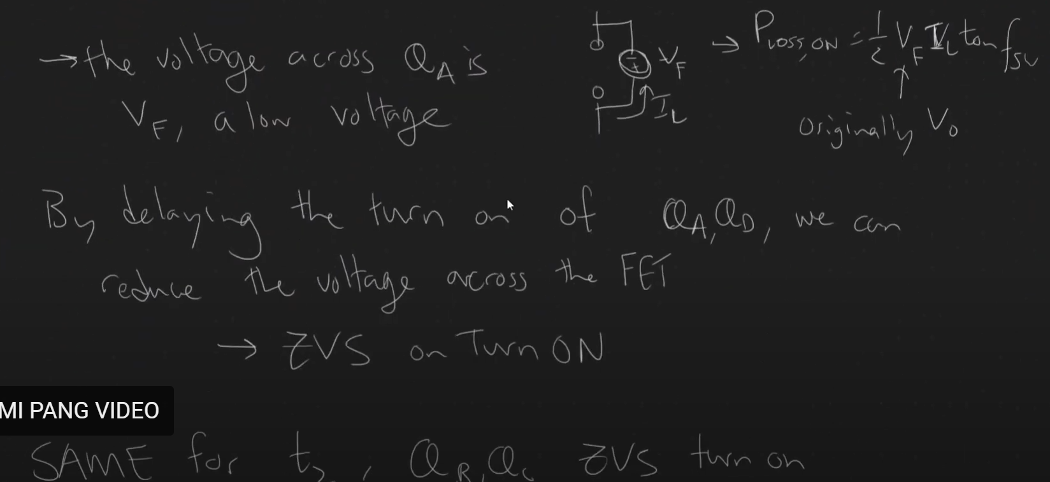

Slide 11
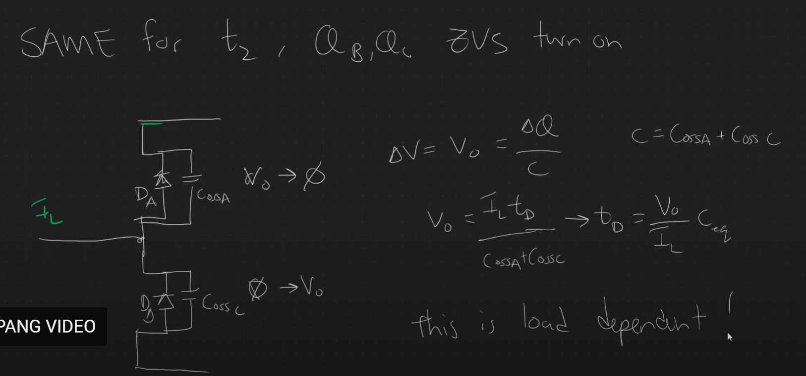
Deadtime equation for ZVS

Slide 12
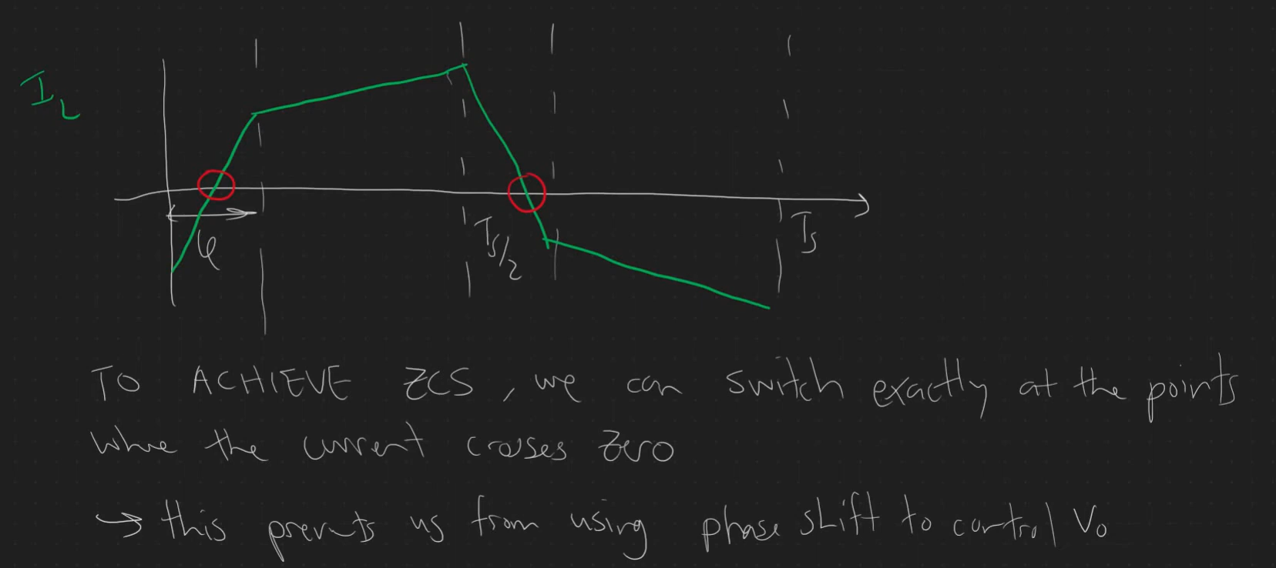
ZCS

Slide 13
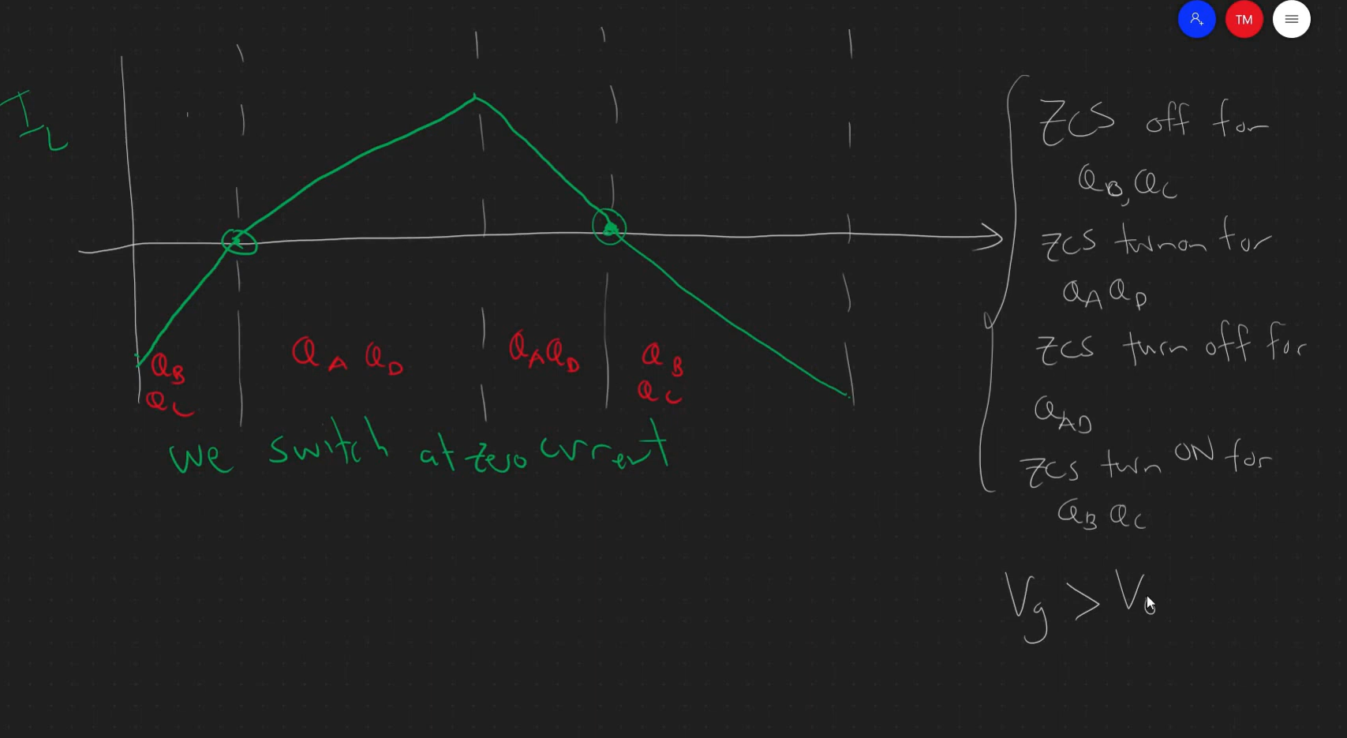
A new modulation to achieve soft switching ZCS

Slide 14
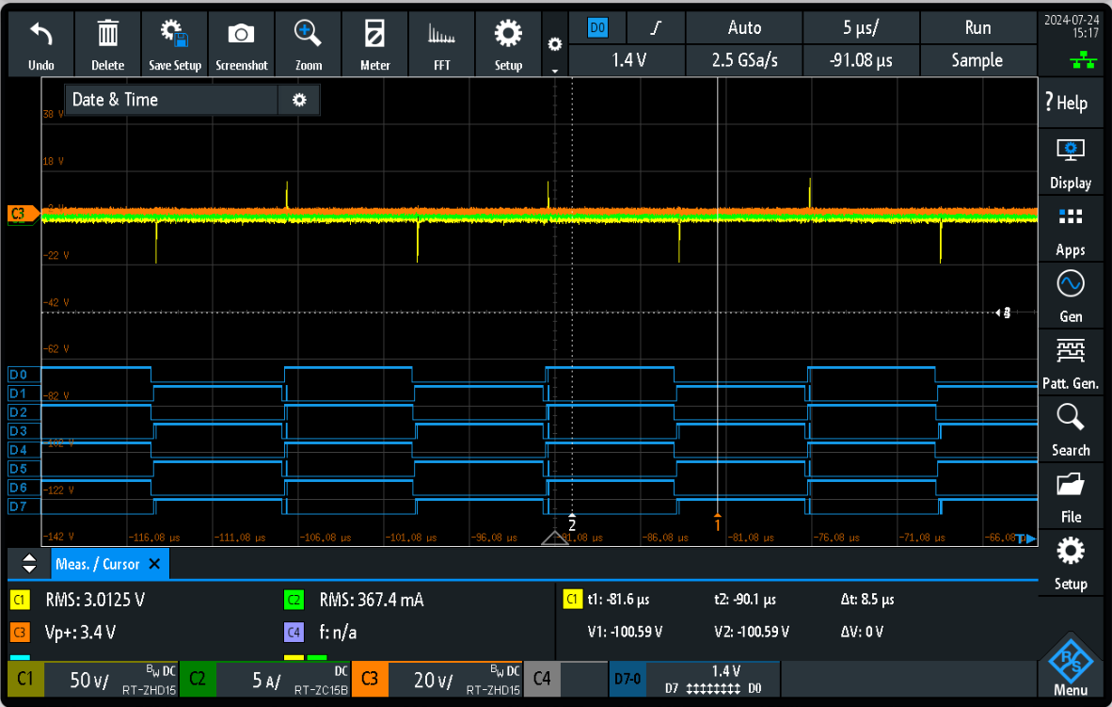
Actual testing to the DAB board in Garching (Open Loop measurement) – no Power flow
Control Phase: 0 degrees
Primary side PWM
PWM1: D0 D1
PWM3: D2 D3
Secondary side PWM
PWM2: D4 D5
PWM4: D6 D7

Slide 15
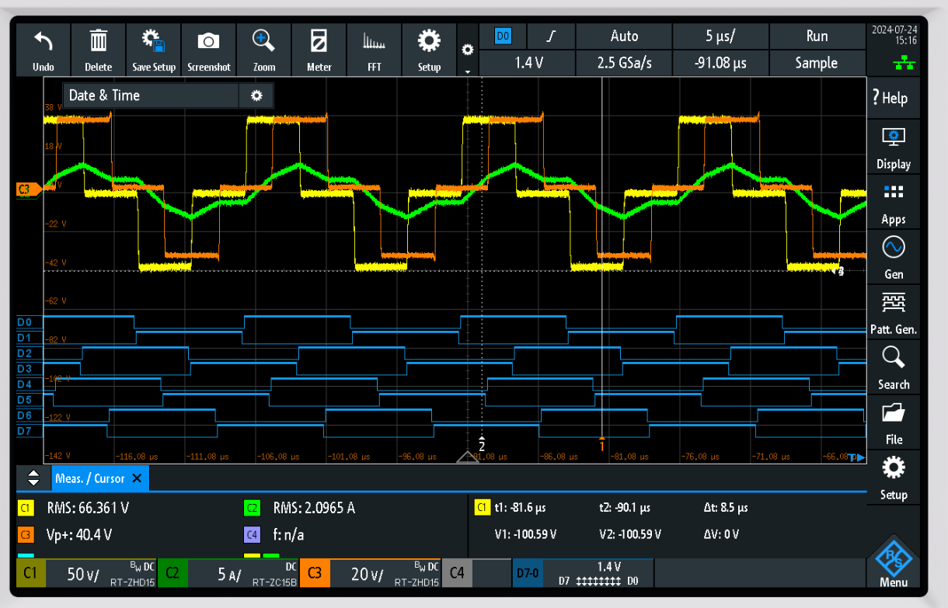
Actual testing to the DAB board in Garching (Open Loop measurement) – with Power flow
Control Phase: 90 degrees
Primary side PWM
PWM1: D0 D1
PWM3: D2 D3
Secondary side PWM
PWM2: D4 D5
PWM4: D6 D7
C1 – yellow (primary Bridge voltage)
C2 - green (transformer current)
C3 - orange (secondary Bridge voltage)

Slide 16
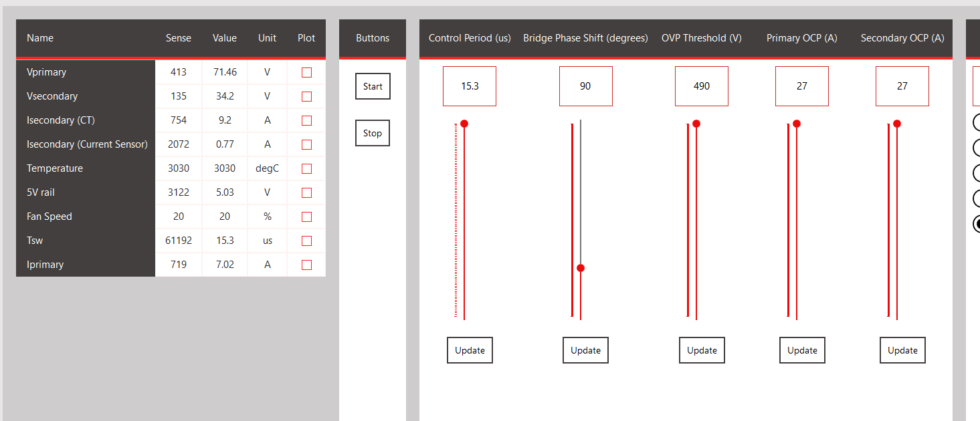
Actual testing to the DAB board in Garching (Open Loop measurement) – with Power flow

Slide 17
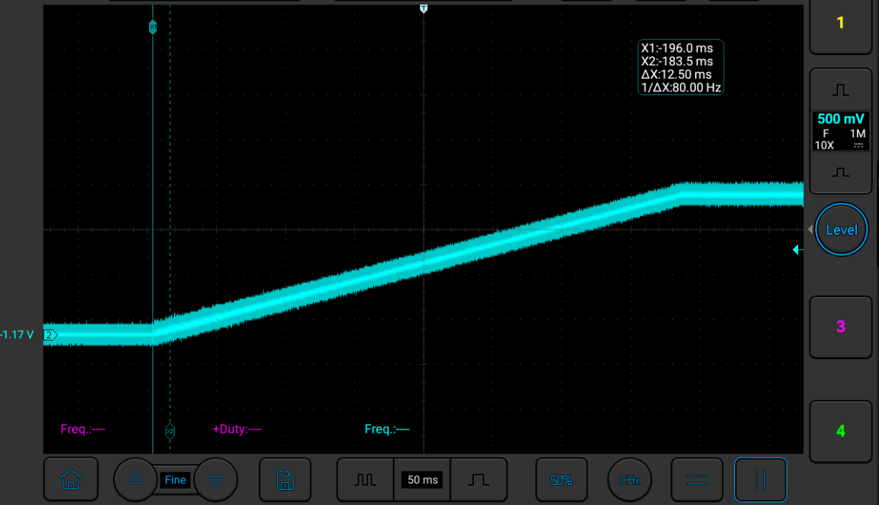
New ramp up –Vloop reference test

Slide 18
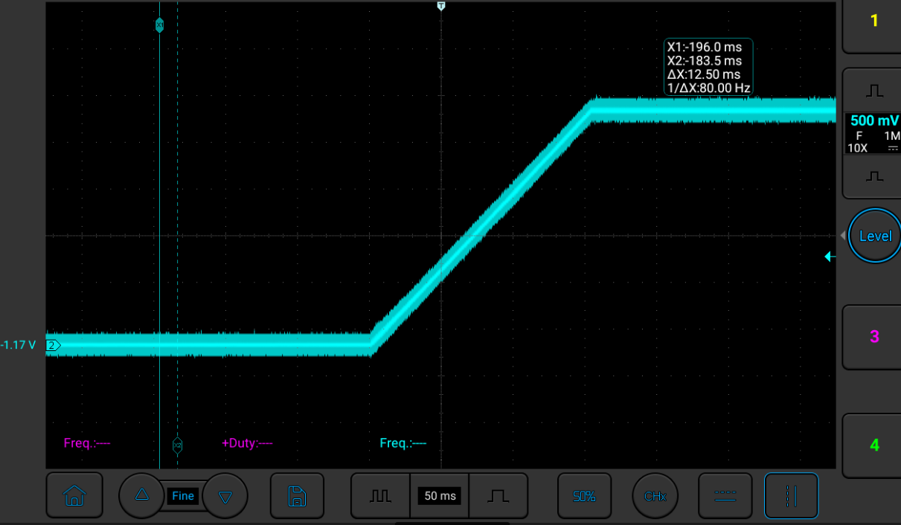
New ramp up –Iloop reference test

Slide 19
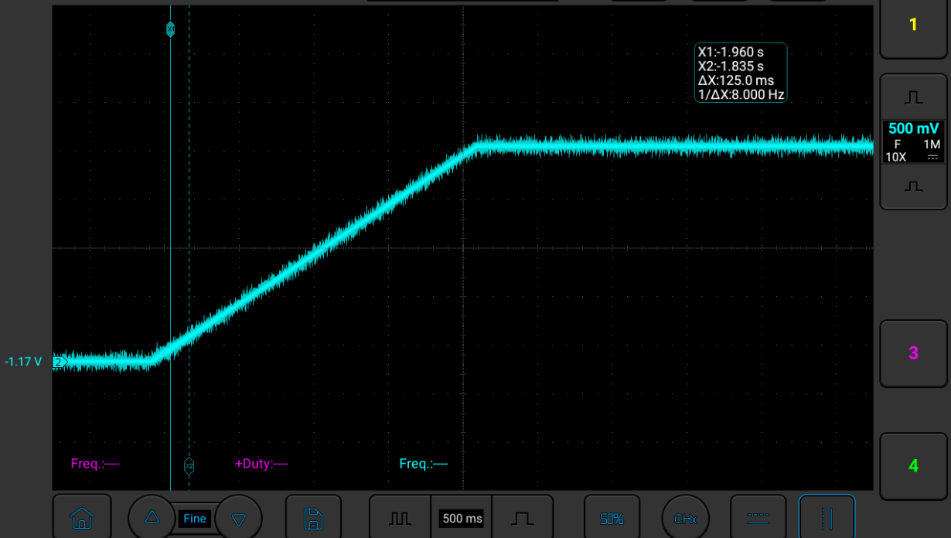
New ramp up –Ploop reference test

Slide 20
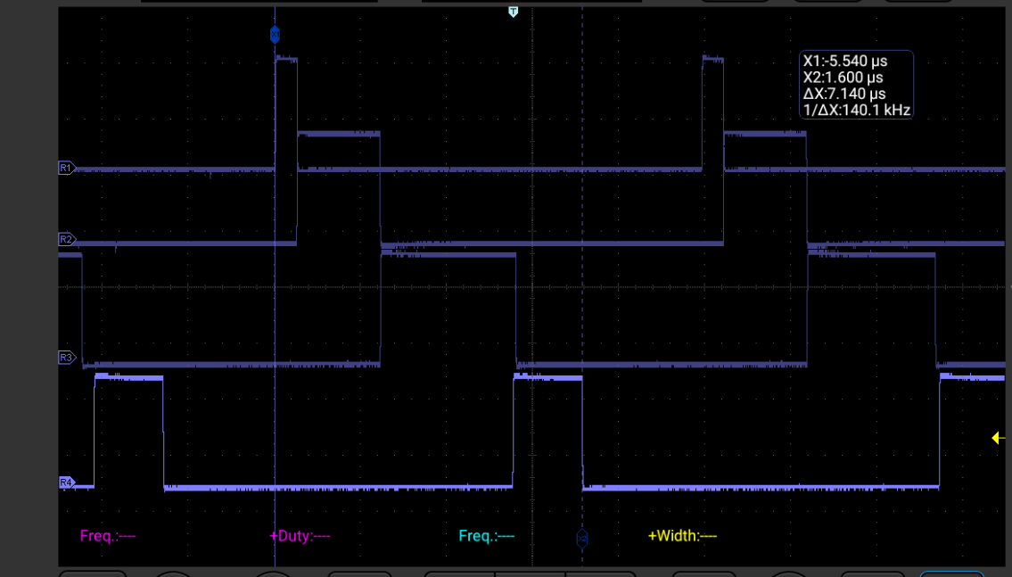
ISR timing tasks :: 100KHz execution time
ADC capture – 504.2 ns
Fault execute – 1.925 us
Control Loop IVP– 3.1 us
PWM distribution– 1.612 us

Slide 21
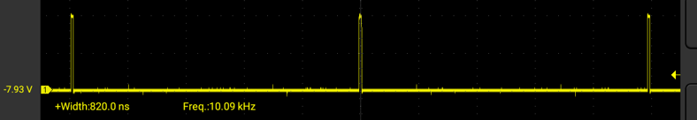
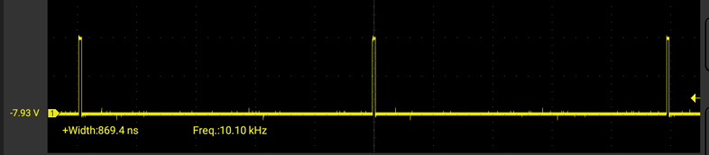
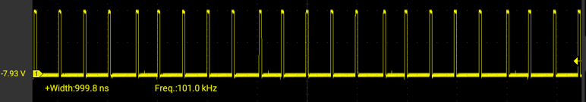
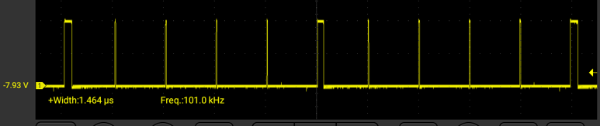
Control loop execution
Vloop
Ploop
Iloop
With averaging code
Interleaved execution
of Vloop and PLoop
Interleave switchover (127ns)

Slide 22
Firmware Structure

Slide 23
Firmware Structure
main.c file
System_Initialize
Power Control Initialize
Fault Initialize
main_tasks.c
Power Control Execute
Pwrctrl State Machine
MCC extension user configuration
Callback Initialization
OS_Scheduler
Tasks_100us
Fault Execute Fault Checks
Operating System Initialize
Power Board Visualizer Initialize
LED Initialize
Fan Initialize
Temperature Initialize
Tasks_1ms
PBV Task Uart Communication Handling
Tasks_10ms
Tasks_100ms
PBV Task
CAN Communication Handling
Tasks_1s
LED Execute Fan Execute Temperature Execute
Scheduler Run Forever
Watchdog Clear
PBV Task Uncritical PBV data
ISR::
ADC measurement Control Loop Execution PWM distribution

Slide 24
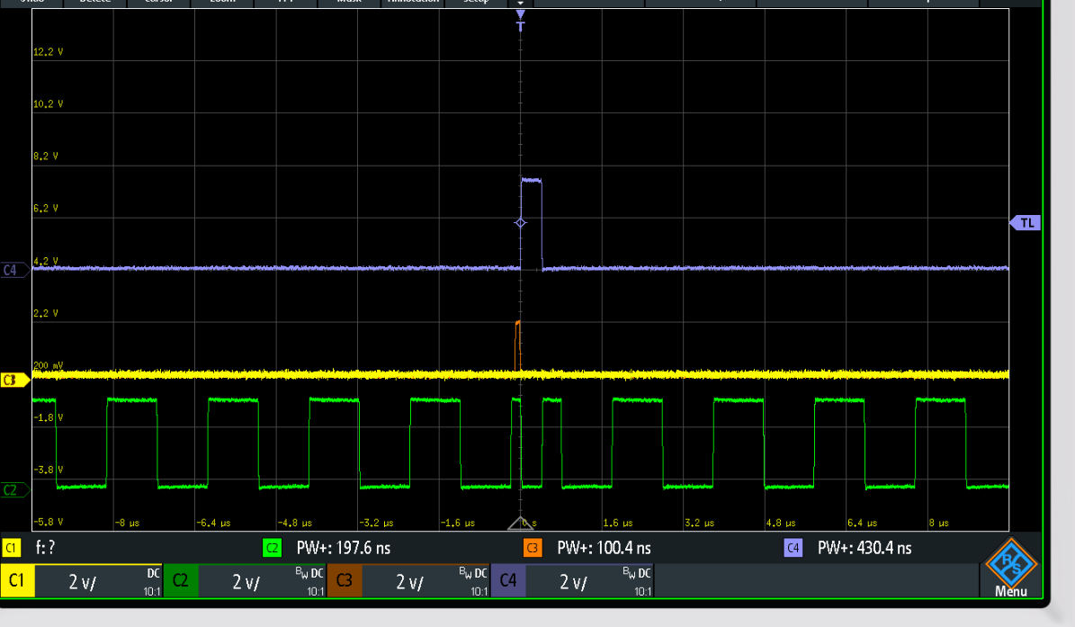
CMP digital filter ( off)

Slide 25
CMP digital filter (on)

Slide 26
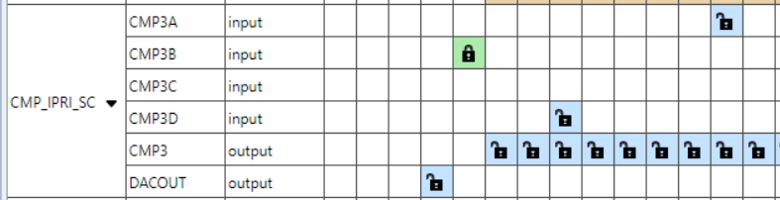
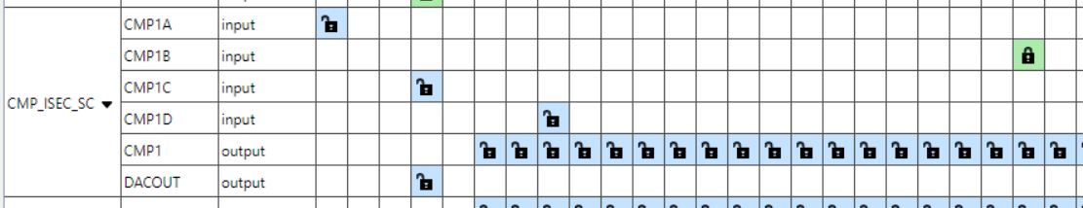

Slide 27
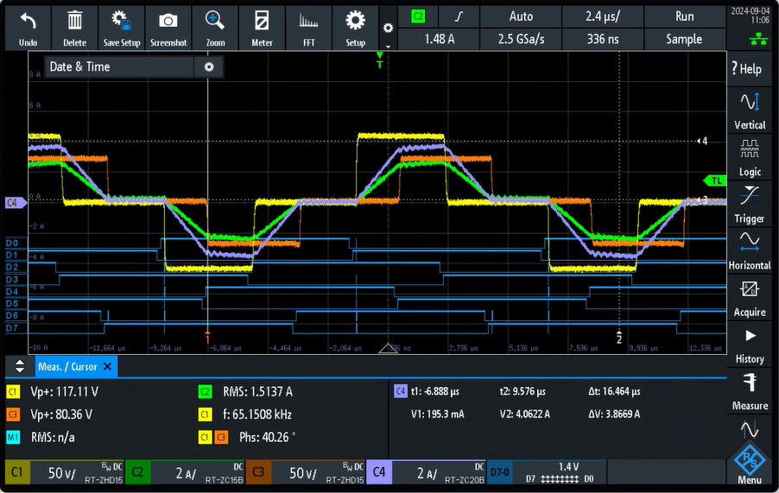
DAB Garching test

Slide 28
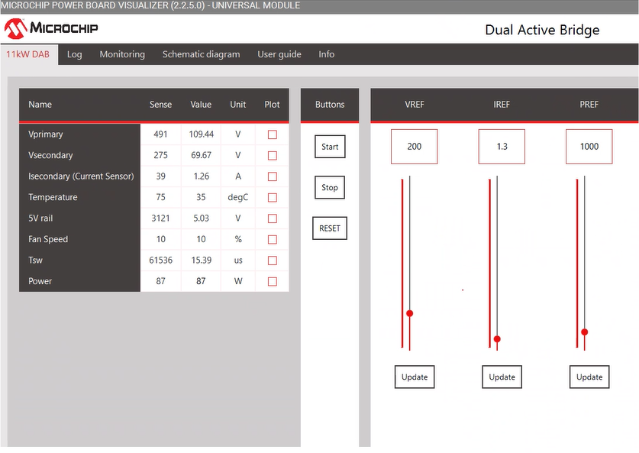

Slide 29
Deadtime checking

Slide 30
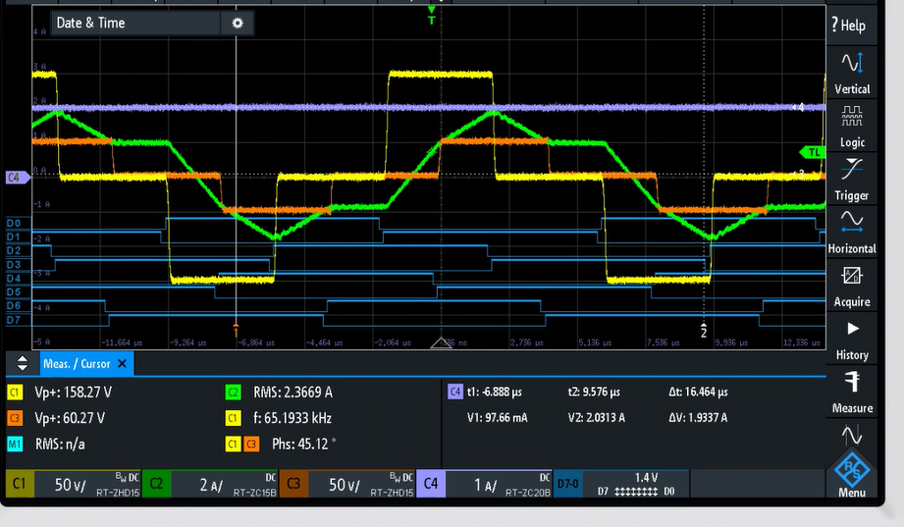
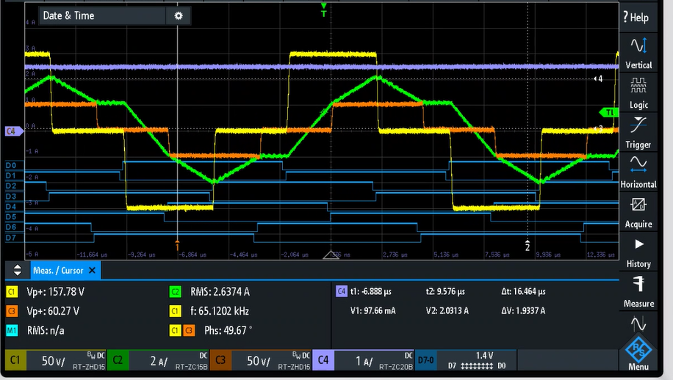

Slide 31
